Slide 1
Sentiment Analysis Research: SMB Cloud ERP solution
Corporate Research Desk
April 10, 2013
TCS Confidential

Slide 2






Sentiment Analysis Research: Overview
MSDynamics was the most discussed player on social media
 | Posts Coverage | Major Media Source | Major Sentiment
 | Extremely High, > 400 | News | Positive
 | High, > 50 | News | Positive
 | 0 | - | -
 | Low, < 10 | News,Blog | Neutral
 | High, > 50 | News | Positive
 | 0 | - | -

Slide 3
Sentiment Analysis Research: MSDynamics
Forums are the most engaging platform for MS dynamics attracting the most number of replies.
Most of the news items are repetitive
Many sentiments are perceived as positive when a company choses other ERP solution over MSDynamics instead of counting it as negative.
Most people chose MSDynamics to improve financial management and reporting as well as streamline key financial processes.
More than 60% of posts come from North America
On the launch of “tomb raider game” Microsoft witnessed a quick surge in the brand mention of Microsoft on January 11.
Sentiment (in %)
Positive | 58
Negative | 30
Neutral | 12
Media Source (in %)
News | 66
Blog | 30
Forum | 4
Total 1927 posts mentioning Microsoft
Positive
The surge in positive posts came when Companies chose to implement MSDynamics and when Microsoft choses a company as Gold MS cloud solution provider.
Negative
The negative sentiments is because of failure of ERP implementations by vendor.
Neutral
Posts perceived as neutral mentions Microsoft as a brand name in related articles.
The second peak in negative posts came when SAP introduced HANA in-memory database
Many posts were wrongly perceived as neutral instead of negative or positive.

Slide 4
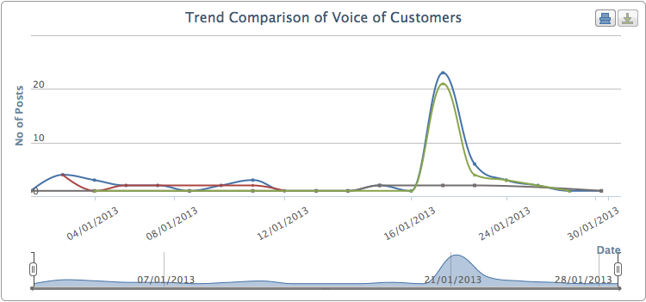
Sentiment Analysis Research: Ramco
 | All Posts
 | Negative
 | Neutral
 | Positive
Sentiment (in %)
Positive | 55
Negative | 23
Neutral | 22
Media Source (in %)
News | 72
Blog | 17
Facebook | 8
YouTube | 2
Forum | 2
Source: Listening Platform
The peak in Ramco news came on 22 January because Ramco signed a contractual agreement to implement Reliability Information Management System for Emirates Engineering department.
Analysis
More than 75% posts come from North America
Total 60 posts mentioning Ramco

Slide 5
Sentiment Analysis Research: SAP ByDesign
Analysis
Most of the reviews are from SAP’s own blog. These reviews talks about the case studies of different companies adopting SAP’s solution.
Most of the posts talk about savings from the solution implementations and short time of implementation.
Sentiments in many posts are captured wrongly as negative instead of neutral.
Sentiment (in %)
Positive | 0
Negative | 25
Neutral | 75
Media Source (in %)
News | 50
Blog | 50
Forum | 0
Only 4 post mentioning SAP ByDesign

Slide 6
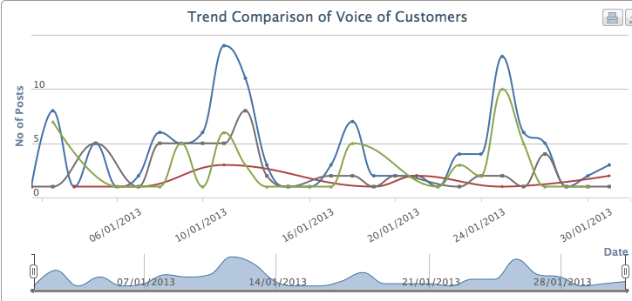
Sentiment Analysis Research: Tally
Sentiment (in %)
Positive | 46
Negative | 9
Neutral | 45
 | All Posts
 | Negative
 | Neutral
 | Positive
Media Source (in %)
News | 54
Blog | 24
YouTube | 12
Forum | 8
Google+ | 2
Source: Listening Platform
Total 120 posts mentioning Tally
“Tally” being a generic word, Most of the posts are wrongly monitored.
Negative
All the posts perceived as negative are wrongly judged. Either they are irrelevant posts or neutral.
Positive
Most of the posts are irrelevant to TallyERP
Neutral
Most of the neutral posts are about either the job posting requiring people well verse in tally ERP or tutorials of Tally ERP.

Slide 7
Sentiment Analysis Research: Sage Software and TreeERP
Sage software and treeERP were not mentioned in any of the posts

Slide 8

Send your feedback / suggestions to the analyst team:
Aditi.Royghatak@tcs.com
Rohit5.j@tcs.com@tcs.com
Sonnet.Das@tcs.com
Visit us on Knowmax at:
https://knowmax.ultimatix.net/sites/mrkt-corpfn/mrktint/default.aspx

